Slide 2
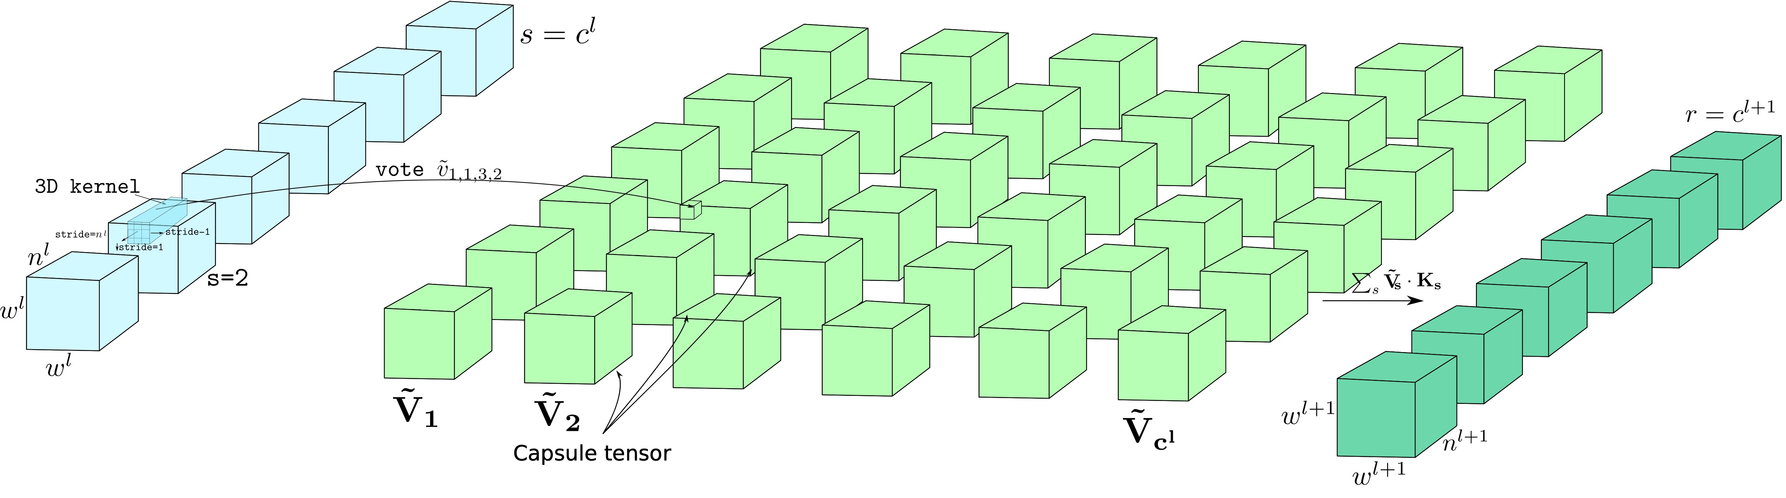
Notes:
Further, a new set of kernels will be used to generate new separate set of capsules for the next level.
Thus, by applying dynamic routing on these capsule tensors, rather than for each capsules, we achieve computational efficient ConvCaps layer.

Slide 3
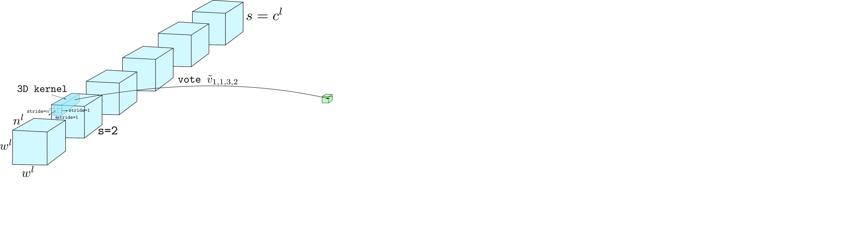
Notes:
Further, a new set of kernels will be used to generate separate set of capsules for the next level.
Thus, by applying dynamic routing on these capsule tensors, rather than for each capsules, we achieve computational efficient ConvCaps layer.

Slide 4
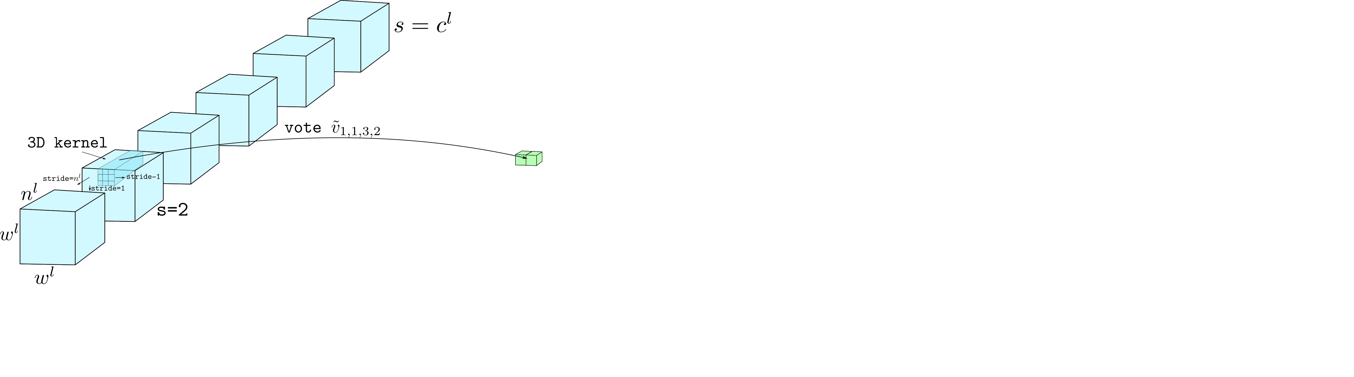
Notes:
Further, a new set of kernels will be used to generate separate set of capsules for the next level.
Thus, by applying dynamic routing on these capsule tensors, rather than for each capsules, we achieve computational efficient ConvCaps layer.

Slide 5
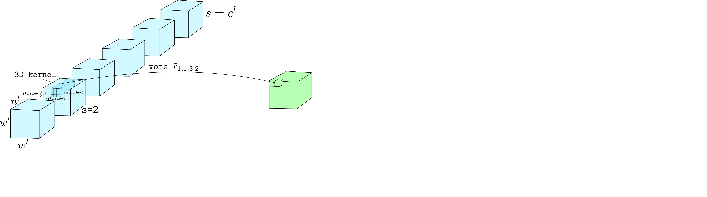
Notes:
Further, a new set of kernels will be used to generate separate set of capsules for the next level.
Thus, by applying dynamic routing on these capsule tensors, rather than for each capsules, we achieve computational efficient ConvCaps layer.

Slide 6
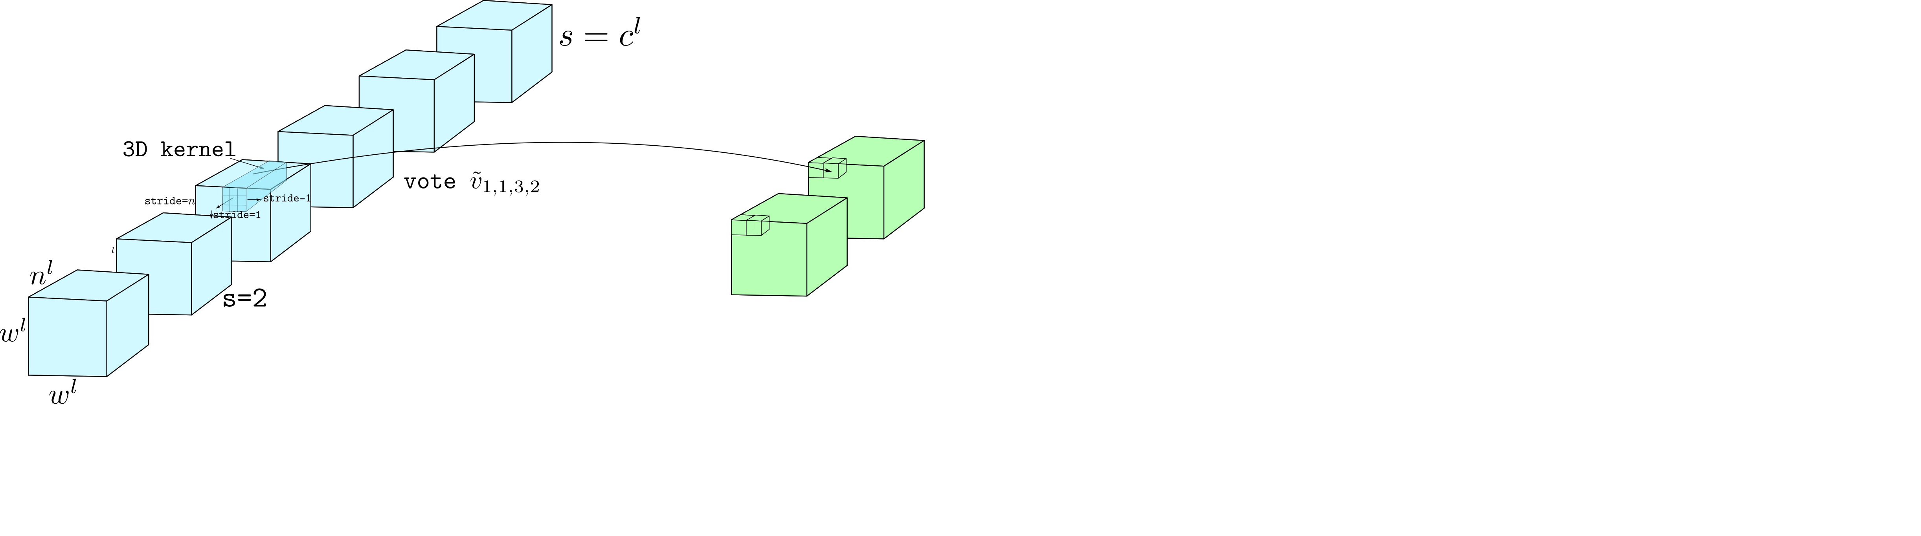
Notes:
Further, a new set of kernels will be used to generate separate set of capsules for the next level.
Thus, by applying dynamic routing on these capsule tensors, rather than for each capsules, we achieve computational efficient ConvCaps layer.

Slide 7
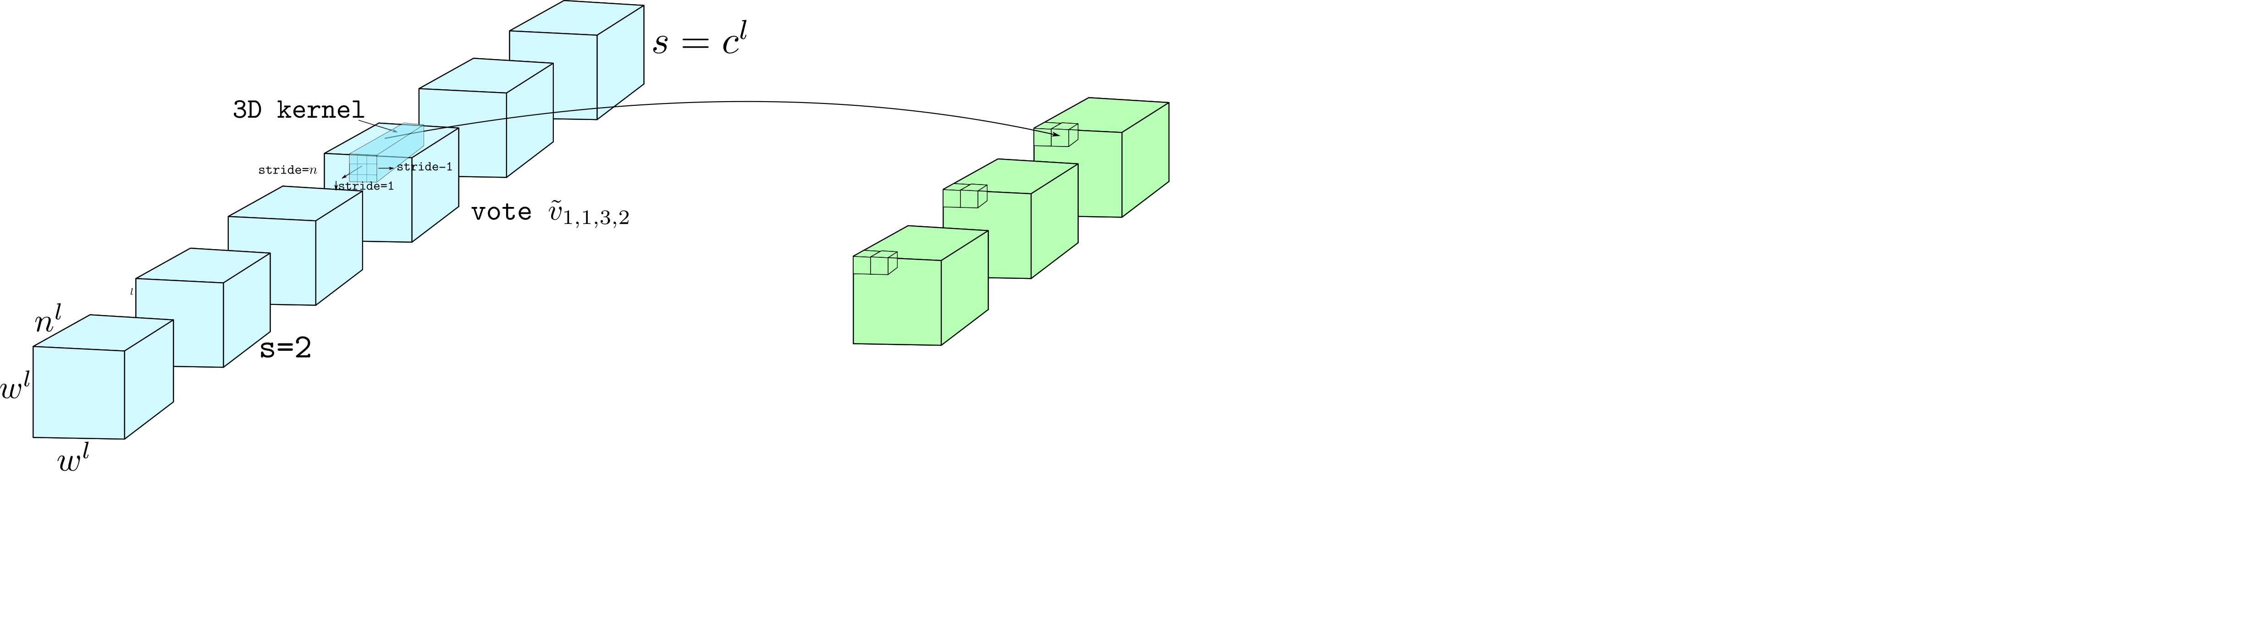
Notes:
Further, a new set of kernels will be used to generate separate set of capsules for the next level.
Thus, by applying dynamic routing on these capsule tensors, rather than for each capsules, we achieve computational efficient ConvCaps layer.

Slide 8
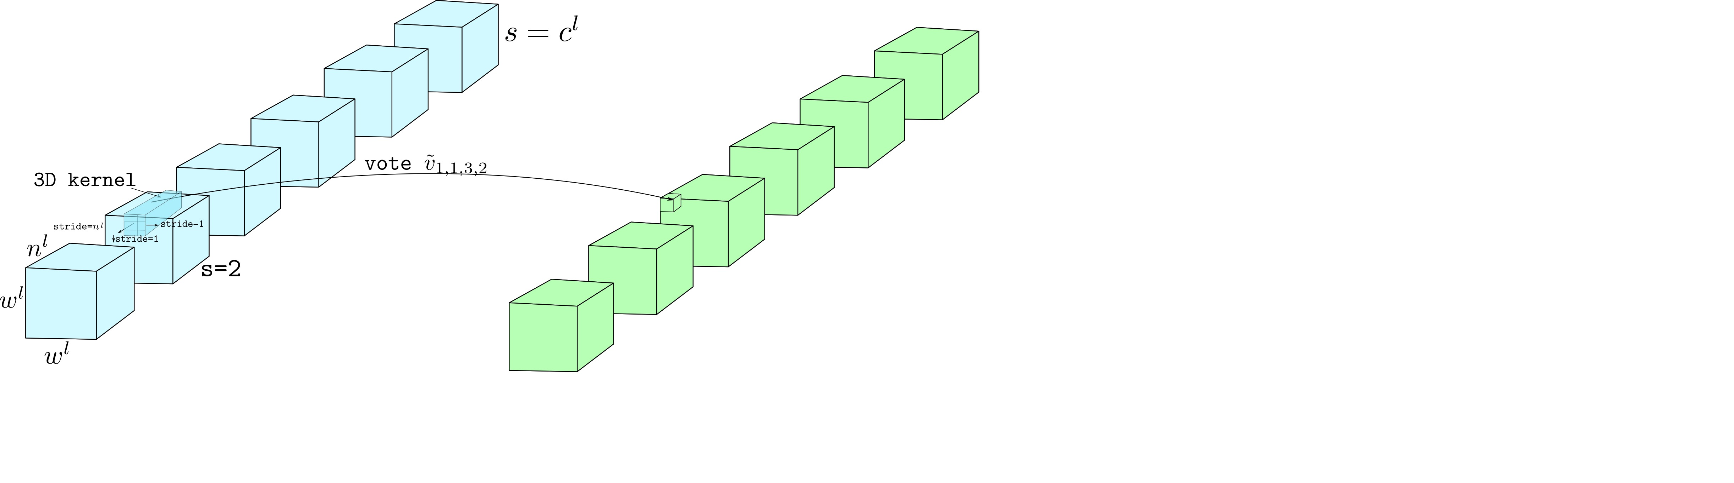
Notes:
Further, a new set of kernels will be used to generate separate set of capsules for the next level.
Thus, by applying dynamic routing on these capsule tensors, rather than for each capsules, we achieve computational efficient ConvCaps layer.

Slide 9
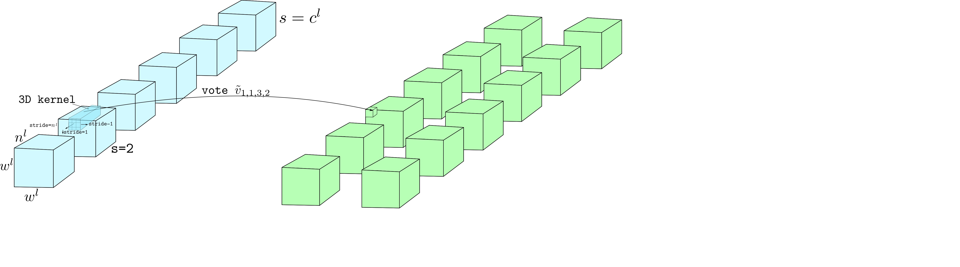
Notes:
Further, a new set of kernels will be used to generate separate set of capsules for the next level.
Thus, by applying dynamic routing on these capsule tensors, rather than for each capsules, we achieve computational efficient ConvCaps layer.

Slide 10
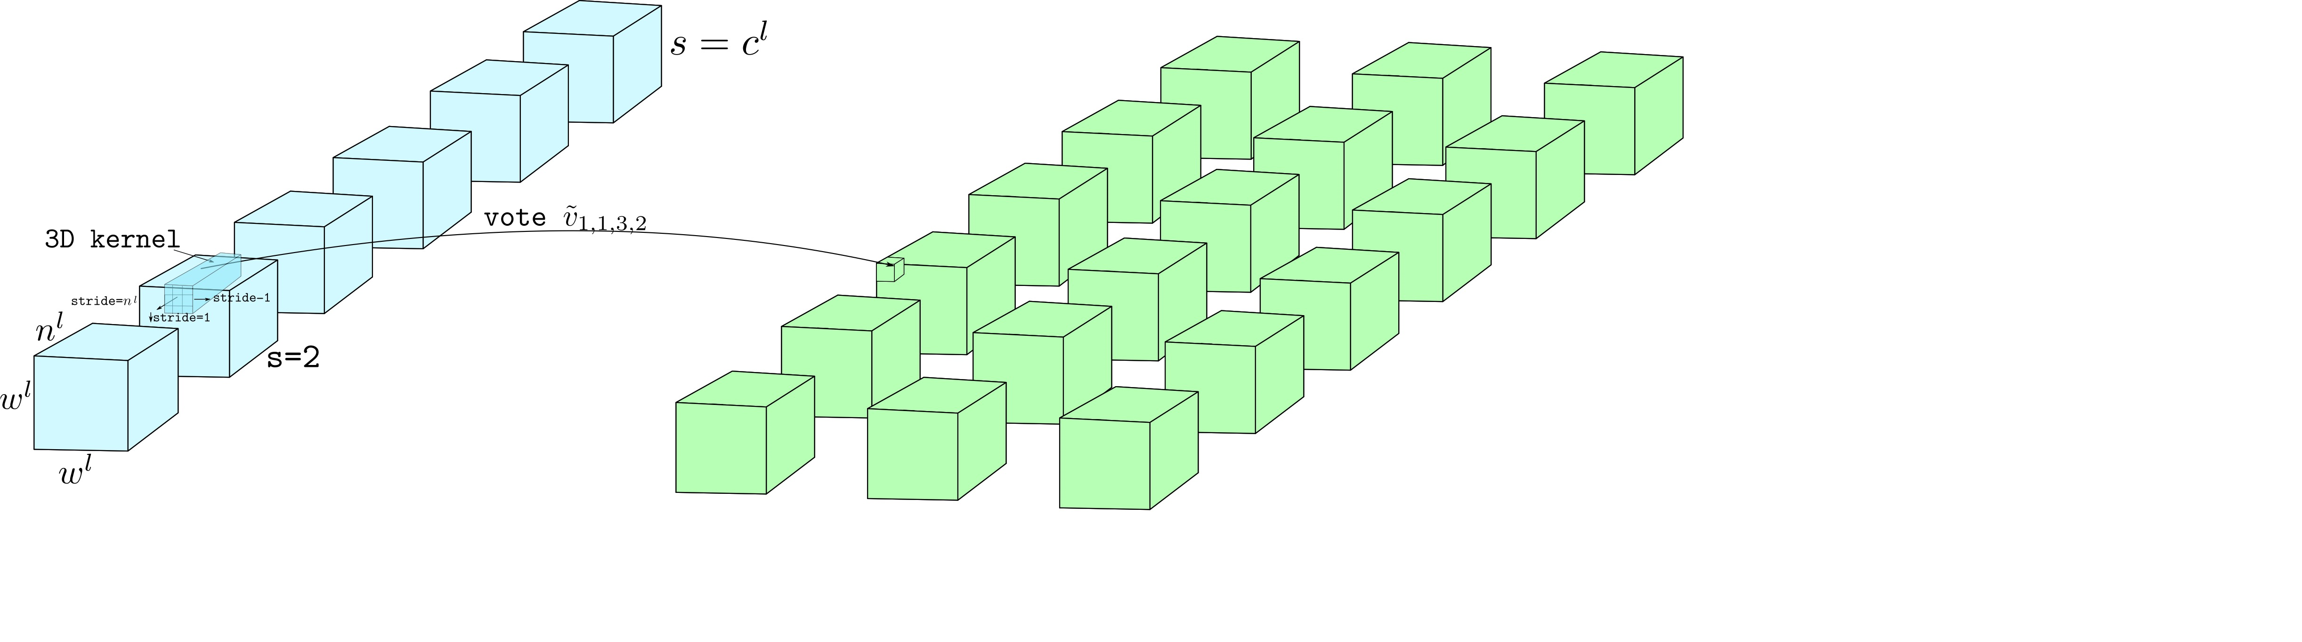
Notes:
Further, a new set of kernels will be used to generate separate set of capsules for the next level.
Thus, by applying dynamic routing on these capsule tensors, rather than for each capsules, we achieve computational efficient ConvCaps layer.

Slide 11
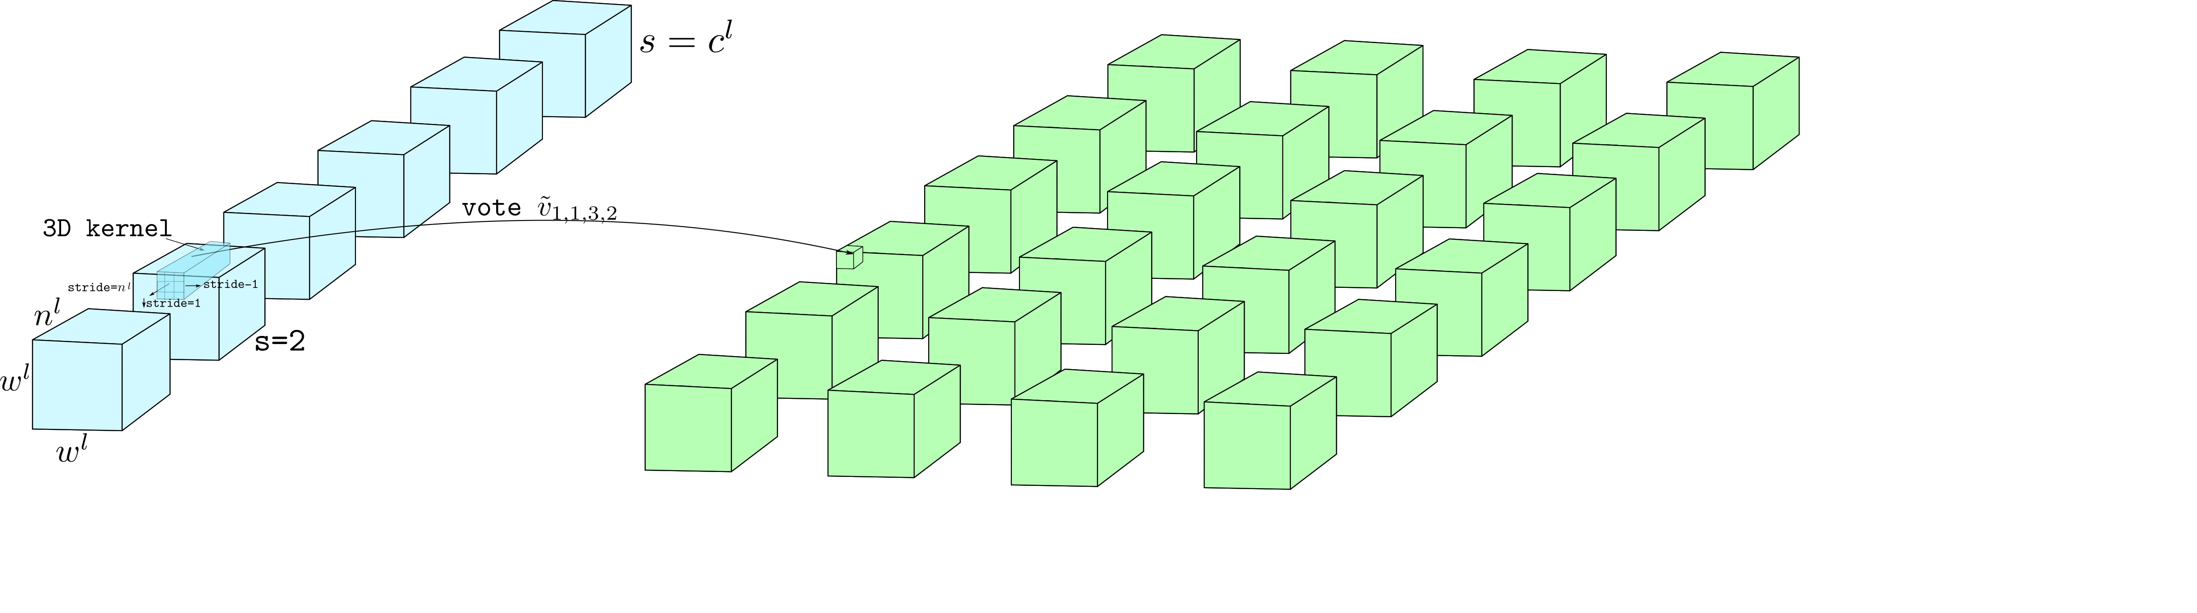
Notes:
Further, a new set of kernels will be used to generate separate set of capsules for the next level.
Thus, by applying dynamic routing on these capsule tensors, rather than for each capsules, we achieve computational efficient ConvCaps layer.

Slide 12
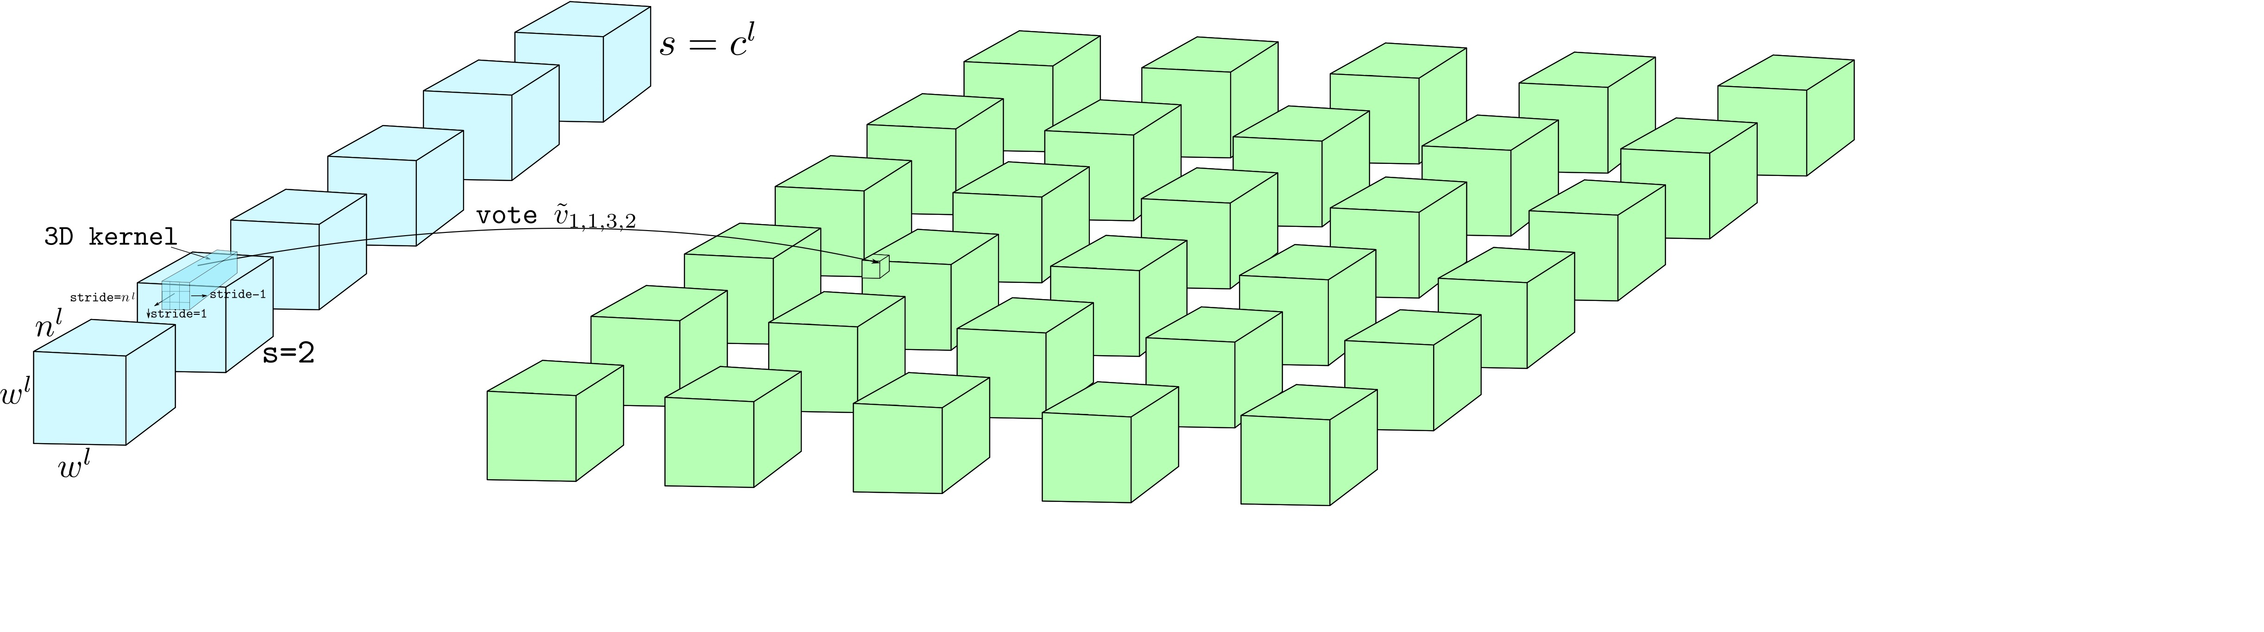
Notes:
Further, a new set of kernels will be used to generate separate set of capsules for the next level.
Thus, by applying dynamic routing on these capsule tensors, rather than for each capsules, we achieve computational efficient ConvCaps layer.

Slide 13
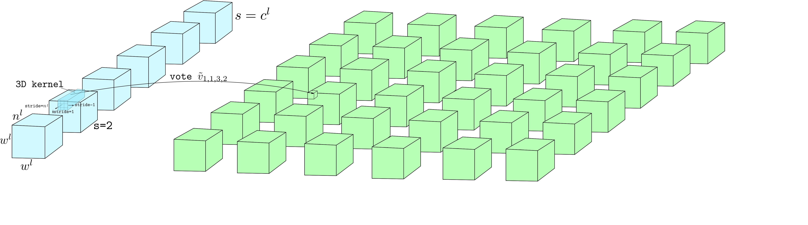
Notes:
Further, a new set of kernels will be used to generate separate set of capsules for the next level.
Thus, by applying dynamic routing on these capsule tensors, rather than for each capsules, we achieve computational efficient ConvCaps layer.

Slide 14
Notes:
Further, a new set of kernels will be used to generate new separate set of capsules for the next level.
Thus, by applying dynamic routing on these capsule tensors, rather than for each capsules, we achieve computational efficient ConvCaps layer.

Slide 15
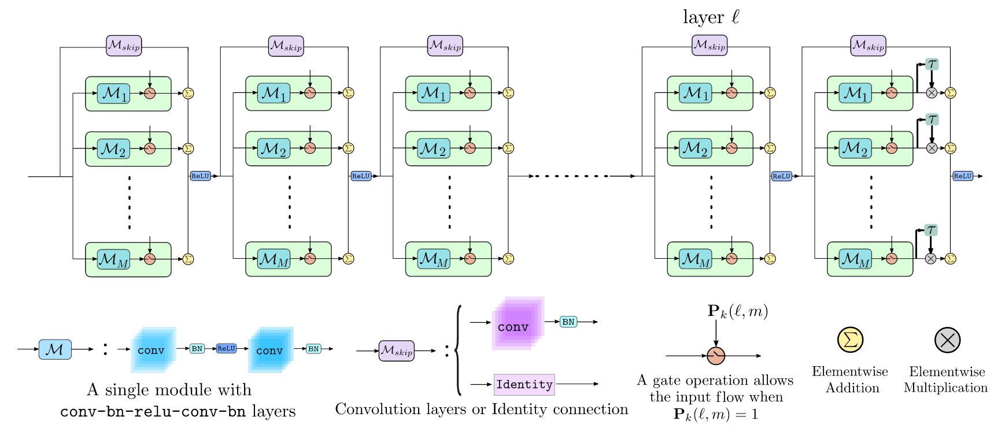

Slide 16
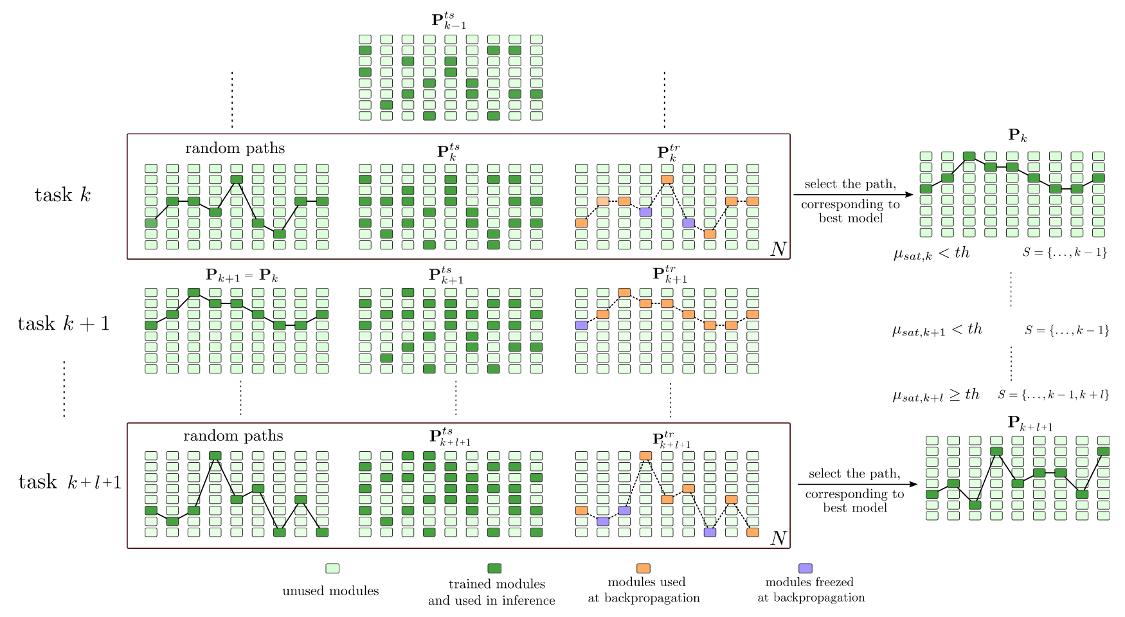

Slide 17
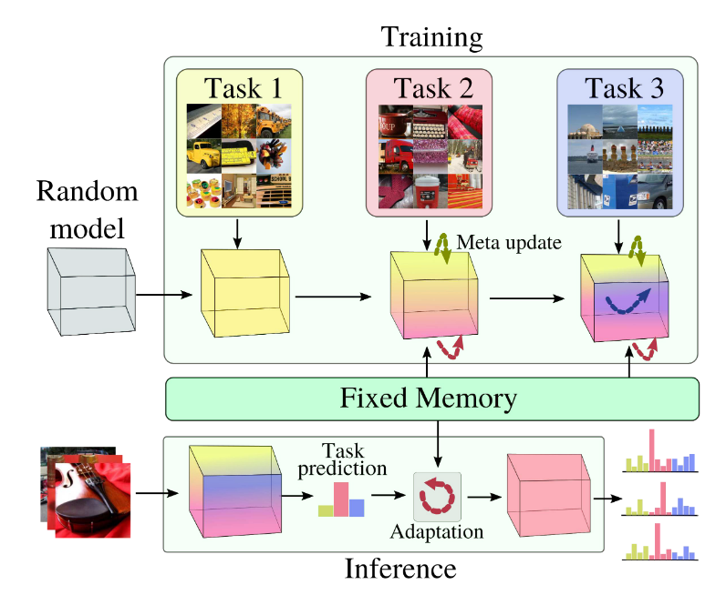

Slide 18
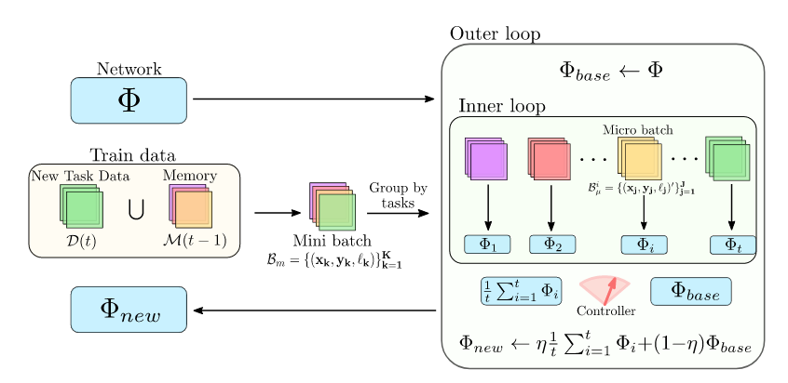

Slide 19
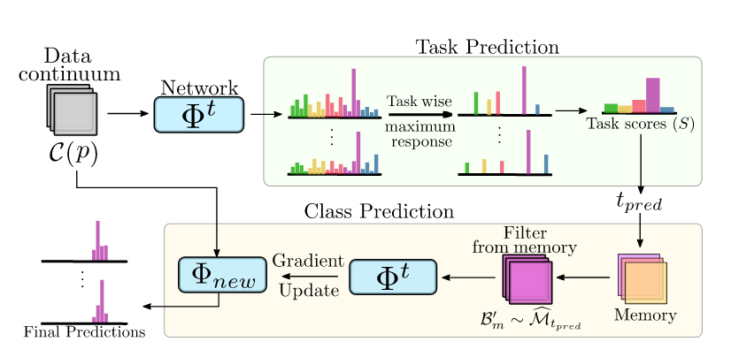

Slide 20


Slide 21


Slide 22


Slide 23


Slide 24


Slide 25

Appearance Block 1
ResNet
Block 4
Features
1 x 1 x 2048
Conv & Up
Concat
Conv
ResNet
Block 3
Features
16 x 16 x 1024
Conv
Appearance Block 2
ResNet
Block 3
Features
32 x 32 x 512
Appearance Block 3
2x Up
ResNet
Block 3
Features
64 x 64 x 256

Slide 26
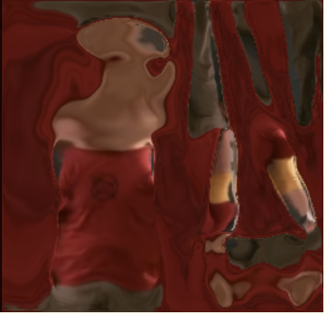
Transformer
t-3
t-2
t-1
t
t+1
t+2
Appearance features
Learnable Appearance token
Temporal Tokens

